Slide 1

1
Food Delivery &
Customer Analytics Platform(E-COMMERCE ORDER & CUSTOMER
ANALYTICS)
Excel Dashboard & Business Insights
Tool: Microsoft Excel
Dataset: 100,000 food-delivery orders
Focus: Orders • Revenue • Customers • Delivery • Ratings
Explanation: This project presents a complete food-delivery analytics solution built in Microsoft Excel. The dashboard brings orders, revenue, customers, restaurants, delivery performance and customer experience into one management view. The purpose is to convert a large transactional dataset into simple business insights that can support faster decisions.

Slide 2
1. Project Objective
2
What the dashboard is designed to answer
• Track overall order volume, revenue, customers and restaurants.
• Understand which cuisines, cities and restaurants generate the most demand.
• Measure delivery performance, payment preferences, order status and customer segments.
• Use KPI cards and charts to support faster business decisions.
TOTAL ORDERS
100,000
Order volume
TOTAL REVENUE
₹5.68 Cr
Overall revenue
CUSTOMERS
24,529
Customer base
The objective is to understand the complete customer-order journey, from demand generation to delivery and customer satisfaction. The dashboard helps management identify high-performing cities and cuisines, understand customer segments, monitor operational performance and find areas where service quality can be improved.

Slide 3
2. Dataset & Excel Structure
3
The workbook contains raw data plus analysis-ready sheets
ORDERS
100,000
Transaction records
CUSTOMERS
24,529
Customer master data
RESTAURANTS
500
Restaurant records
FOOD ITEMS
48
Food catalogue
Orders — Main transaction-level dataset
Customers — Customer profile and segment information
Restaurants — Restaurant-level reference data
Food_Items — Food item and cuisine information
Monthly_Summary — Monthly orders, customers and revenue
KPI / Pivot sheets — Dashboard-ready calculations and summaries
The workbook is structured so that raw transactional information can be separated from reference data and analysis sheets. This improves clarity and makes the dashboard easier to refresh. The project uses order-level data together with customer, restaurant, food-item and summary information to create a complete analytical model.

Slide 4
3. Key Performance Indicators
4
High-level metrics visible at the top of the dashboard
Total Orders
100,000
Order volume
Customers
24,529
Customer base
Restaurants
500
Restaurant network
Revenue
₹5.68 Cr
Revenue
Average Order Value
₹552
Per-order average
Avg Delivery Time
32.3 min
Delivery speed
On-time Delivery
32.5%
Reliability
Customer Rating
4.2 / 5
Experience
The KPI layer gives management an immediate snapshot of business health. Total orders and customers show scale, revenue shows commercial performance, average order value indicates spending behavior, while delivery time, on-time delivery and rating indicate service quality. Together, these KPIs create a balanced view of growth and operations.

Slide 5
4. Monthly Orders & Revenue Trend
5
April 2024 to April 2025
The monthly trend analysis helps identify changes in demand and revenue over time. A manager can compare strong and weak months, investigate unusual changes and connect operational or promotional activities with order performance. This type of trend monitoring can also become the foundation for future forecasting.

Slide 6
5. Demand by Cuisine & City
6
Where customer demand is concentrated
Cuisine and city analysis reveals where customer demand is concentrated. Understanding the leading cuisines can support menu partnerships and promotional campaigns, while city-level demand analysis can help with restaurant onboarding, delivery capacity planning and targeted marketing.

Slide 7
6. Customer & Operational Performance
7
Service quality and customer behavior
AVG DELIVERY TIME
32.3 min
Operational speed
ON-TIME DELIVERY
32.5%
Reliability
CUSTOMER RATING
4.2/5
Experience
CANCELLATION RATE
5.0%
Orders cancelled
• Delivered orders are the largest status category.
• Operational improvement should focus on reducing cancellations and improving on-time performance.
Customer and operational analysis connects demand with service quality. Order status, delivery time, on-time delivery, ratings and cancellation behavior should be viewed together because operational problems can directly affect customer satisfaction, repeat purchases and long-term revenue.

Slide 8
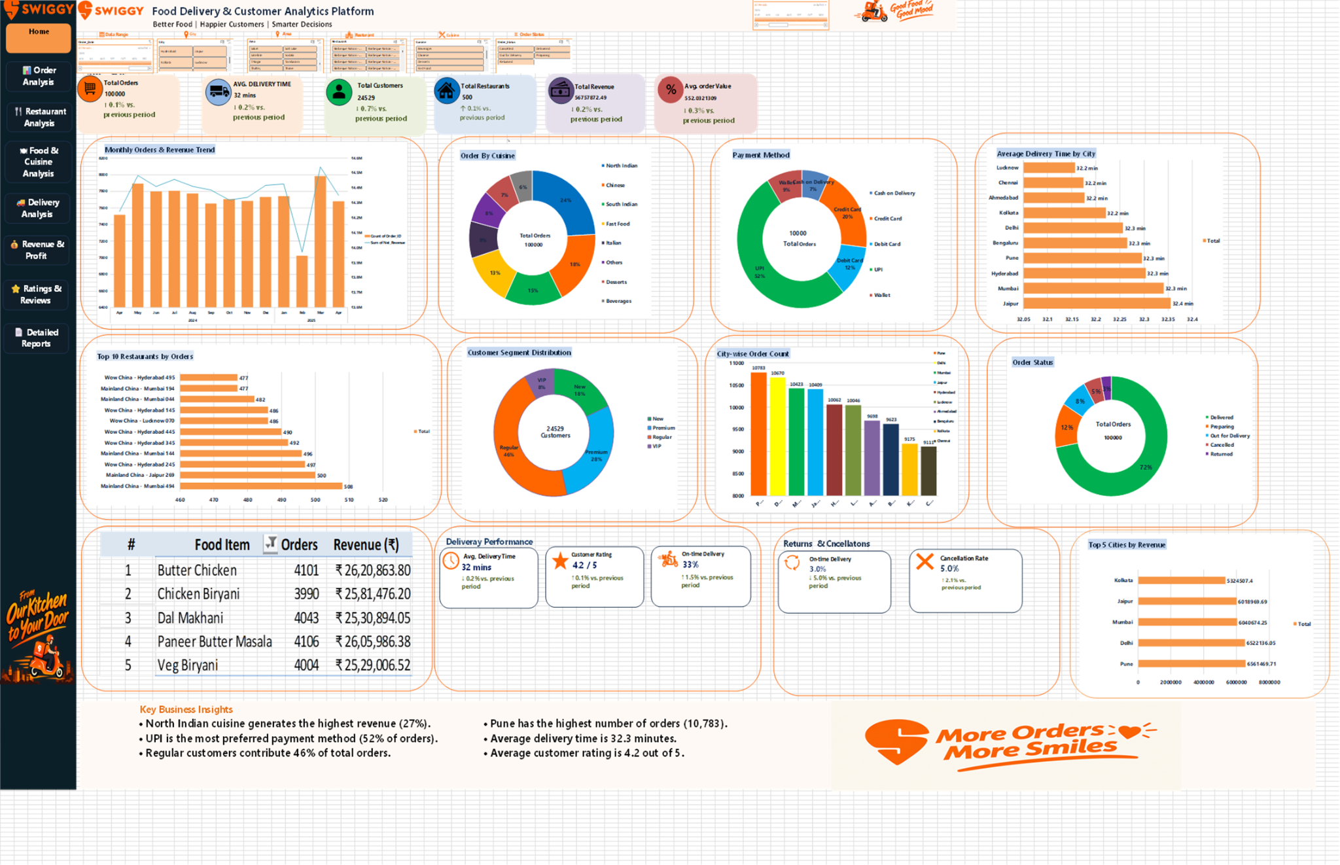
7. Dashboard Walkthrough
8
A single-page management view
The dashboard is designed as a single-page management view. KPI cards provide the headline numbers, charts explain the trends and distributions, rankings highlight top performers, and detailed information supports deeper investigation. This reduces the time required to move from raw data to an actionable conclusion.

Slide 9
8. Key Business Insights & Recommendations
9
What management can take away from the analysis
Key Insights
• North Indian is the leading cuisine by order volume.
• Pune has the highest order count (10,783).
• UPI accounts for about 52% of orders.
• Regular customers contribute about 46% of orders.
• Average delivery time is about 32.3 minutes and rating is about 4.2/5.
Recommended Actions
• Promote high-performing cuisines and city-specific offers.
• Use UPI-focused promotions because it is the dominant payment method.
• Improve delivery reliability to raise on-time performance.
• Target regular customers with loyalty and repeat-order campaigns.
• Monitor cancellations and returned orders as operational warning indicators.
The analysis highlights several business opportunities. High-performing cuisines and cities can receive targeted promotions, dominant payment methods can be supported with offers, regular customers can be encouraged through loyalty programs, and delivery or cancellation problems can be monitored as early warning signals.

Slide 10
9. Data Preparation & Cleaning
11
Turning raw records into analysis-ready information
• Checked the dataset structure and identified important fields for orders, customers, restaurants, food items and transactions.
• Reviewed missing, duplicate or inconsistent values before using the data for analysis.
• Standardized categories such as cuisine, city, payment method and order status.
• Verified numeric fields such as sales, revenue, quantity, delivery time and ratings.
• Created summary calculations and Pivot-style analysis sheets for dashboard reporting.
STEP 1
Clean
Improve data quality
STEP 2
Transform
Create analysis-ready fields
STEP 3
Summarize
Build KPIs and Pivot analysis
Before building charts, data quality is critical. Cleaning and standardization make sure that categories are counted correctly and that the dashboard represents the underlying business data rather than errors in the source.

Slide 11
10. Analytical Methodology
12
How the project moves from raw data to business insight
Understand
Identify business questions and important fields.
Prepare
Clean and organize the transaction data.
Calculate
Create KPIs, ratios and summary measures.
1
2
3
Analyze
Compare trends, categories, cities and segments.
Visualize
Build charts and an executive dashboard.
Interpret
Convert patterns into recommendations.
4
5
6
The methodology follows a structured analytics pipeline. Instead of creating charts directly from raw data, the project first establishes data quality, then calculates reliable measures, identifies patterns and finally translates those patterns into business recommendations.

Slide 12
11. Customer Segmentation & Retention
13
Understanding customer groups for targeted marketing
New Customers
Acquisition
Welcome offers and first-order incentives
Regular Customers
Core base
Loyalty rewards and repeat-order offers
Premium Customers
High value
Personalized benefits and premium experiences
VIP Customers
Highest priority
Exclusive offers and retention campaigns
• Segmentation helps avoid sending the same offer to every customer.
• The strongest retention opportunity is to move regular customers toward higher-value behavior.
• Customer-level analysis can later be combined with purchase frequency and average order value.
Customer segmentation changes the dashboard from simple reporting into a marketing decision tool. Each segment can receive a different strategy, improving relevance, retention and the probability of repeat orders.

Slide 13
12. Restaurant Performance Analysis
14
Identifying high-demand restaurant patterns
• Top restaurant rankings show where order demand is concentrated.
• Restaurant performance can be compared using order volume, revenue, average order value and customer ratings.
• Low-performing restaurants can be investigated for pricing, menu, delivery time or customer-experience issues.
• High-performing restaurants can become candidates for campaigns, featured placement and strategic partnerships.
MANAGEMENT QUESTION
Who is driving demand?
Use ranking and trend analysis
MANAGEMENT QUESTION
Where is performance weak?
Compare cities and service metrics
MANAGEMENT QUESTION
How can we grow?
Promote proven performers
Restaurant analysis can help the business decide which partners to support, which locations need attention and where additional restaurant acquisition may create the greatest impact.

Slide 14
13. Payment & Delivery Experience
15
Connecting transaction behavior with customer experience
PAYMENT BEHAVIOR
UPI-led
Digital payments are a major part of the order journey
DELIVERY
Monitor time
Track average and on-time performance
SERVICE QUALITY
Track rating
Customer feedback is a quality signal
• Payment analysis can guide cashback, coupons and payment-partner campaigns.
• Delivery-time analysis can reveal operational bottlenecks.
• Ratings and cancellations provide customer-experience feedback.
• Combining these metrics gives a more complete view than analyzing each metric separately.
A food-delivery platform is both a commerce business and a service business. Payment convenience may influence conversion, while delivery reliability and service quality strongly influence satisfaction and repeat behavior.

Slide 15
14. Management Decision Framework
16
How decision-makers can use the dashboard
Marketing
Which city/cuisine should receive the next campaign?
Operations
Where should delivery capacity be improved?
Customer Success
Which segments need retention actions?
Partnerships
Which restaurants are strategic performers?
Finance
How are revenue and order trends changing?
Strategy
Which locations show long-term growth potential?
The dashboard becomes valuable when every visual answers a business question. Different teams can use the same data for different decisions, creating a common analytical language across marketing, operations, finance and strategy.

Slide 16
15. Current Limitations & Improvement Areas
17
What can be improved in the present Excel solution
• Excel is highly useful for descriptive and diagnostic analytics, but it is less suitable for very large real-time datasets.
• The current dashboard mainly explains what happened; it does not yet predict future demand automatically.
• Real-time delivery tracking and live customer behavior are outside the current static workbook workflow.
• Advanced statistical testing, machine learning and automated alerts can further improve decision support.
• A centralized database or cloud platform would improve scalability as data volume grows.
Recognizing limitations is important in a top-level project presentation. The current solution is strong for structured reporting and business analysis, while the next stage is to add automation, predictive analytics, real-time data and scalable architecture.

Slide 17
16. Future Scope
18
How this project can evolve into an advanced analytics platform
Real-Time Dashboard
Connect live order and delivery data using APIs or streaming pipelines.
Demand Forecasting
Use time-series or ML models to predict future orders by city and cuisine.
Customer Churn Prediction
Identify customers likely to stop ordering and trigger retention actions.
Recommendation Engine
Recommend food, restaurants and offers based on customer behavior.
Route Optimization
Use geospatial and optimization techniques to reduce delivery time.
Cloud & Automation
Move data to a scalable database and automate refresh, alerts and reporting.
The future scope is to transform the current descriptive dashboard into a predictive and eventually prescriptive platform. Forecasting, personalization, route optimization, real-time monitoring and cloud automation can create measurable business value beyond reporting.

Slide 18
17. Proposed Future Architecture
19
From Excel dashboard to scalable analytics platform
Data Sources: Orders • Customers • Restaurants • Payments • GPS • App events
Data Platform: SQL / Cloud Database • ETL • Data Quality • Historical Storage
Analytics & AI: Forecasting • Segmentation • Recommendations • Churn • Optimization
Visualization: Power BI / Web Dashboard • Alerts • Executive KPIs
Business Actions: Marketing • Delivery Operations • Partner Management • Customer Retention
A future production system could combine multiple data sources, a centralized data platform, machine-learning models and a modern BI layer. The final objective would be a closed loop where data produces insights and insights directly support business actions.

Slide 19
10
Conclusion
• The Excel dashboard provides a consolidated view of food-delivery performance.
• It combines descriptive analytics with business-focused KPIs.
• The analysis highlights demand leaders, customer behavior and operational gaps.
• The same structure can be refreshed with new data for ongoing decision-making.
The overall conclusion is that Excel can be used to build a practical analytics solution when the data is properly organized and the visuals are designed around business questions. The same dashboard framework can be refreshed with new records and gradually upgraded with automation, advanced analytics and predictive models.

Slide 20
20
Final Takeaway
• The project demonstrates practical business analytics using Excel.
• The dashboard converts 100,000+ order records into understandable KPIs and visual insights.
• It supports decisions across marketing, operations, customer retention and restaurant partnerships.
• The future roadmap adds forecasting, AI/ML, real-time data, geospatial optimization and automation.
• This project can therefore serve as a foundation for a larger food-delivery analytics platform.
Thank You • Questions & Discussion
This final slide summarizes the project as an end-to-end analytics solution and opens the presentation for questions. During the Q&A, focus on your contribution, the dashboard logic, the business insights and the future scope.

